Slide 1

Order Up: Best Online Shopping website
Mini Project Presentation
PRESENTED BY:-
Harshita Jaiswal(2000200310014)
CO-ORDINATOR :-
Mr. Aashish Kapoor Sir
BRANCH:-
Electronics & Communication Engineering

Slide 2
Project details
Description :-
Our Project is a online shopping website. In this the Customer can place his\her order and he\she will receive the delivery on their expected time.
Scope :-
In this Project we can add cloths ,authentication through google , wishlist, payment, gateway.
Problem solving :-
We live in era where everyone is living a fast-placed life. People ,especially in cities, live on takeaways instead of cloths . Still, a lot of time is wasted in going and picking up the order ,so we’ve made an online ordering online clothing website which allows people to order their cloths . Our website helps people in browsing menu online and choosing according to their style .
It’s true that nowadays people value their time over anything plus , they want to avoid unnecessary travelling as much as they can. So, our website also provide home delivery.

Slide 3
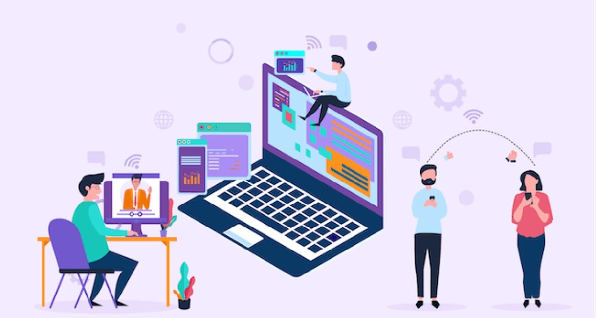
Technology Used
For the front - end we used :-
→HTML
→CSS

Slide 4
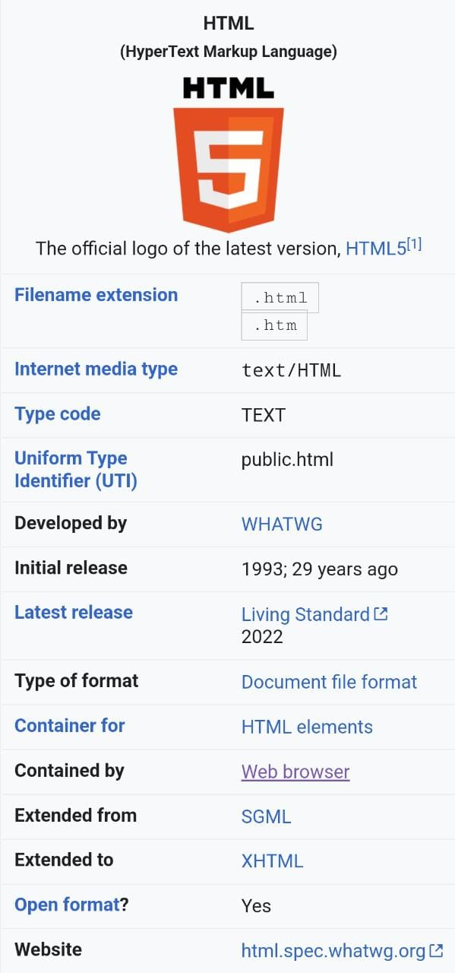

Slide 5
Using tags properly
HTML is made up of a series of pre- defined “Tags”, which are indicated by triangular brackets : eg
This text is tagged as a paragraph
Tags need to be opened and closed:
An opening tag looks like this :
A closing tag looks like this :
Tags must be “nested” :i.e. opened and closed in the correct order:
In practice, this means that when you open a tag which “nests” in another set of tags ,it must be closed before the surrounding tag is closed:
The nested tag must be closed before the surrounding tag.

Slide 6
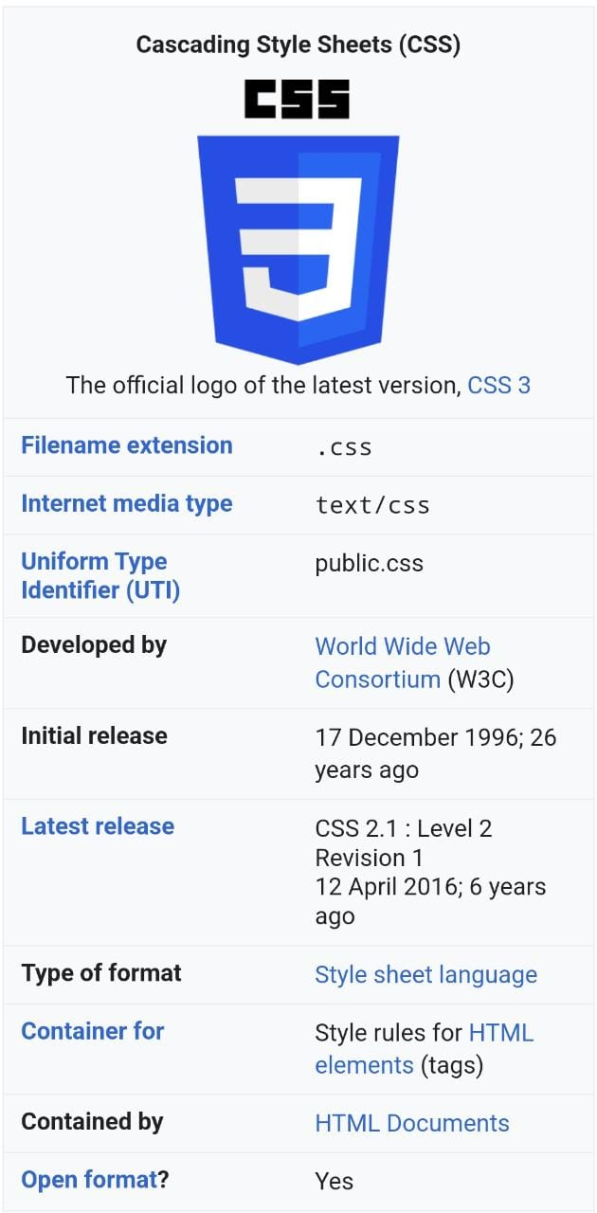

Slide 7
Benefits of CSS
Style rules can be applied to multiple pages.
Changes can be made to one CSS file rather than multiple HTML files.
Browsers retain a copy of CSS, speeding up load times.
CSS can allow for responsive web design on different platforms (desktop, mobile ,tablets etc .).
Separating HTML and style elements improves accessibility, particularly for readers using page reader application.

Slide 8
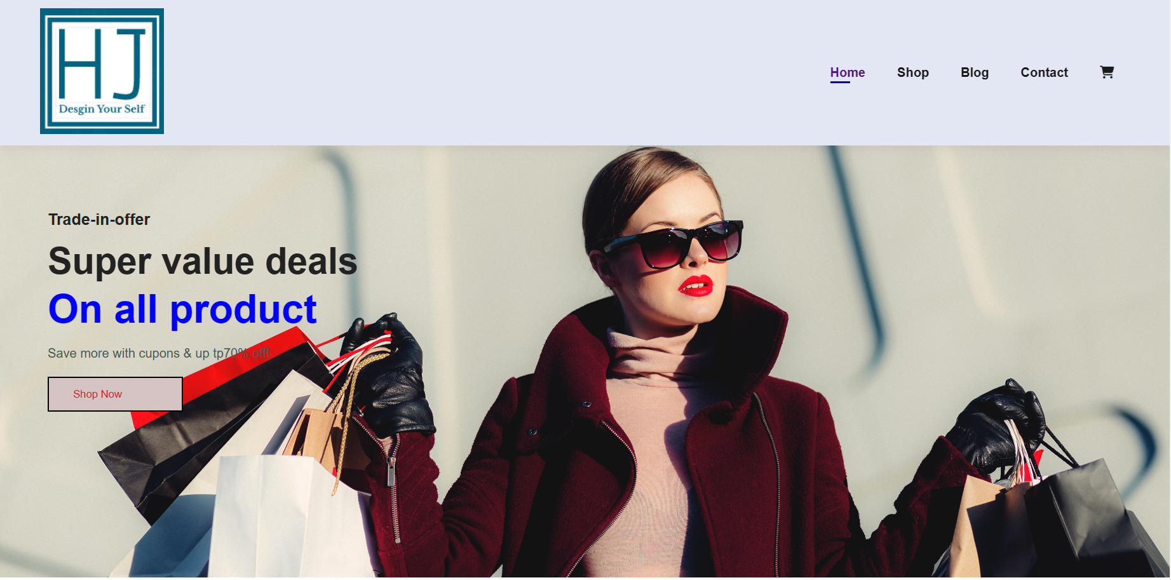
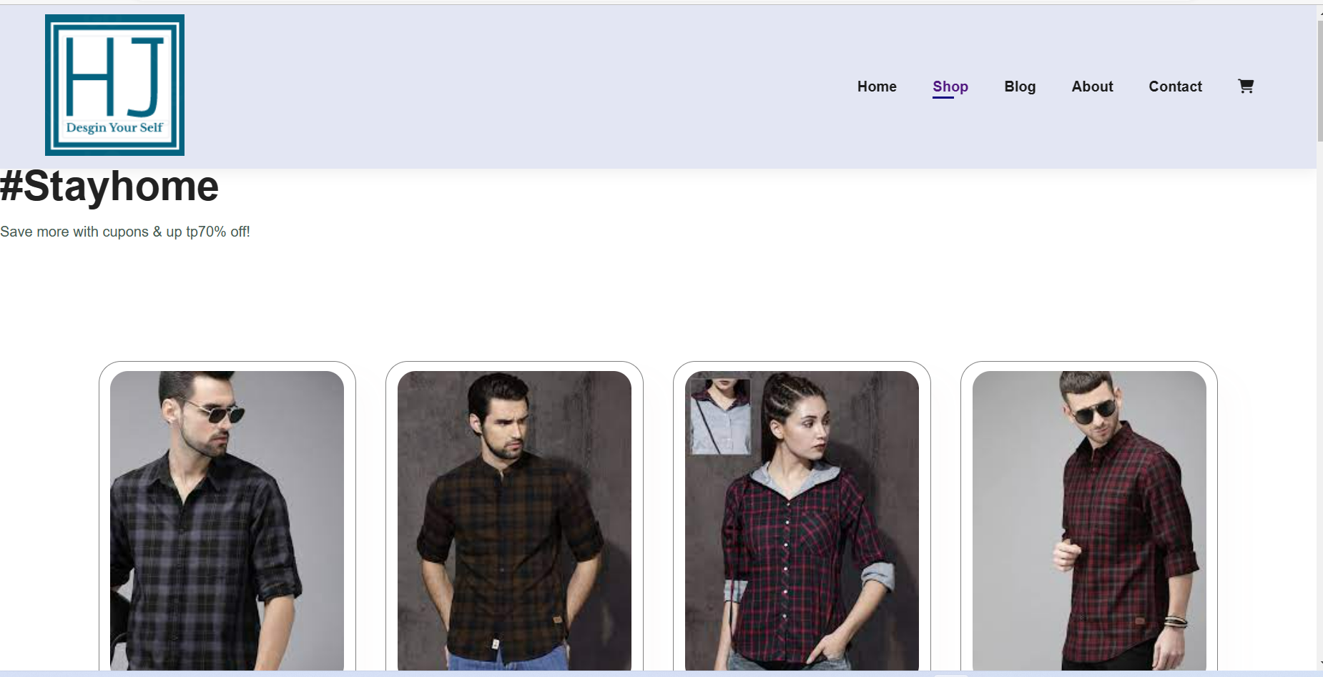
Some Snaps of Website
HOME
SHOP

Slide 9
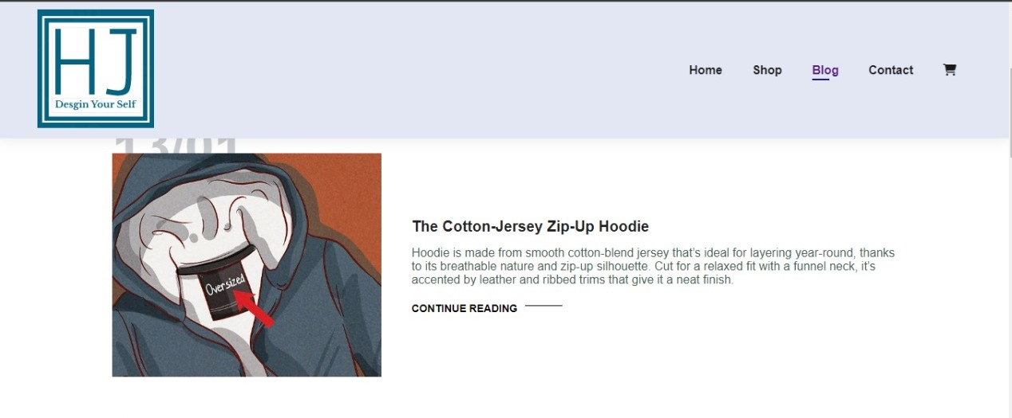
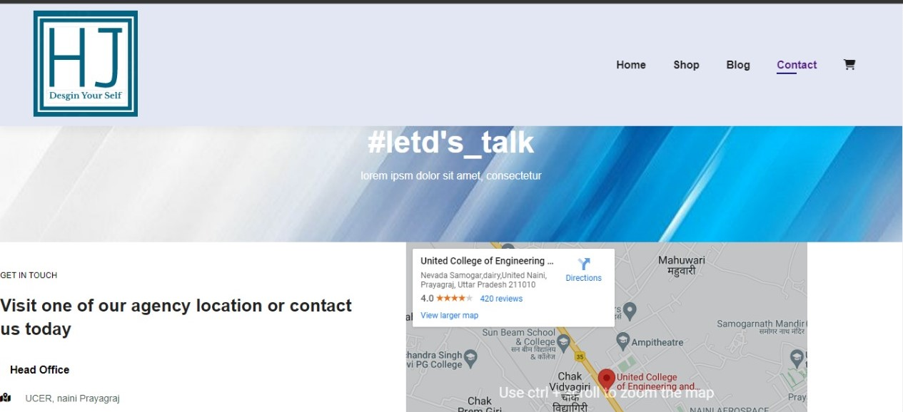
BLOG
CONTACT

Slide 10

FUTURE Scope
A Prevention measure can be added to prevent fake logins.
Users Privacy can be enhanced . Captcha can be added for authentication purpose .
Graphics and Animations can be added to make website more user – friendly &
Interactive

Slide 11

REFERENCES
http://www.geeksforgreeks.org/web-technology/html-css
https://youtu.be/4-QLHECxSTY

Slide 12
Thank You

